Slide 1
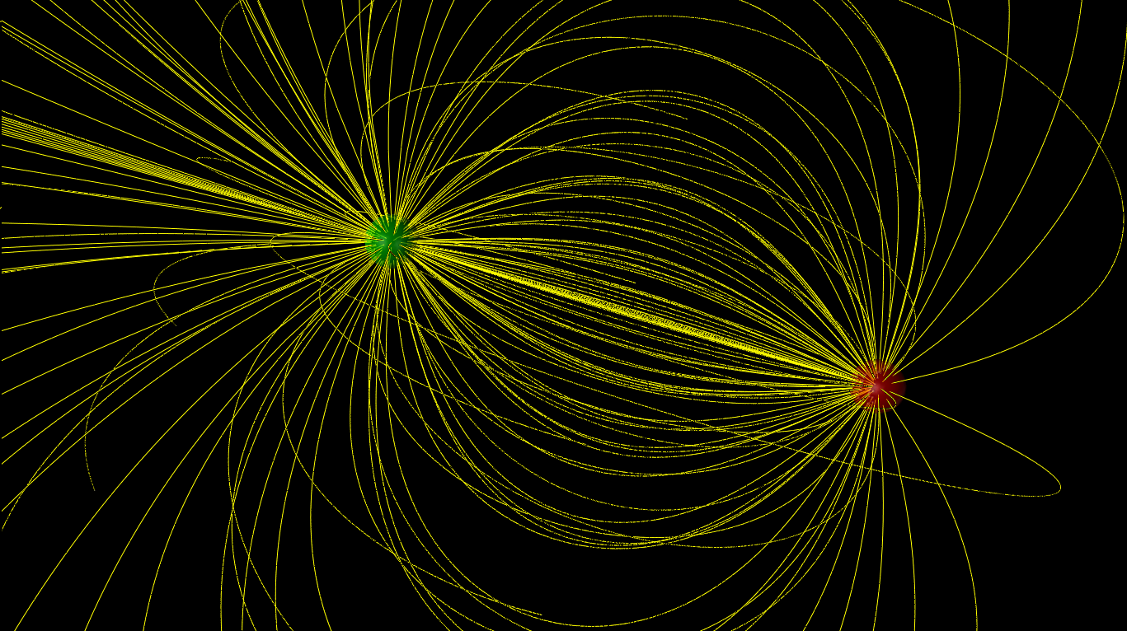

ELECTRIC FIELDS

Slide 2
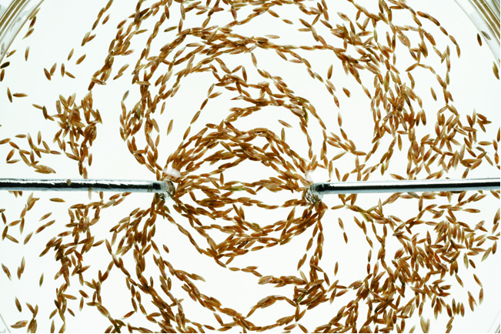
The concept of the electric field
The field model explains how the force due to charges is transmitted through empty space from one charge to another.
The figure shows a shallow pan of oil with grass seeds floating on it. When positive and negative wires touch
the oil, a pattern emerges.
Some kind of electric influence from the charges fills the space around the charges.

Slide 3
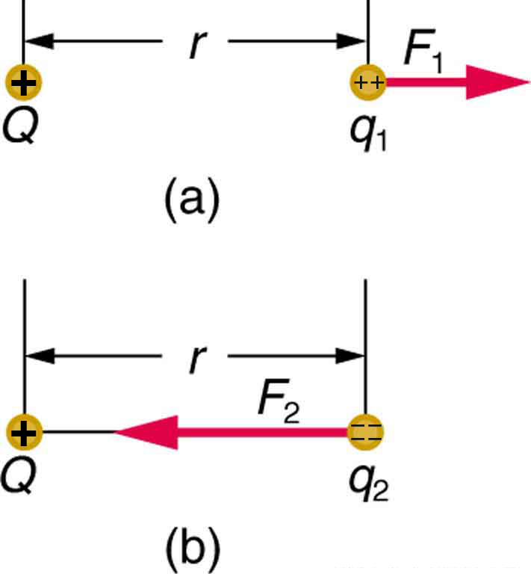

Electric field: introduction
The Coulomb force field due to a positive charge Q is shown acting on two different charges. Both charges are the same distance from Q . (a) Since q₁ is positive, the force F₁ acting on it is repulsive. (b) The charge q₂ is negative and greater in magnitude than q₁, and so the force F₂ acting on it is attractive and stronger than F₁. The Coulomb force field is thus not unique at any point in space, because it depends on the test charges q₁ and q₂ as well as the charge Q.
Specifically, the electric field E is defined to be the ratio of the Coulomb force to the test charge:

Slide 4

Electric field: details
Electric field is a vector.
SI Units: N/C.
Direction of the electric field at a certain location is the same as the direction of the electric force on a positive test charge at this location.
We can think about electric field as “electric force per unit charge”.
The field “belongs” to the source charge. The electric field is independent of the charge q used to probe the field. The electric field depends only on the source charges that create the field.
Note that if the electric field is known at certain location, a charge placed at that
Location will experience the electric force:

Slide 5

The electric field of a point charge
A point charge Q produces an electric field at all points in space. Starting with Coulomb’s law, it is relatively easy to show that:
Note that the field strength decreases with increasing distance.
The field produced by a positive point charge points away from the charge.
The field produced by a negative point charge points toward the charge.
The total electric field at a point is the vector sum of the fields due to all the charges present.

Slide 6
Example: finding the electric field of a proton
The electron in a hydrogen atom orbits the proton at a radius of 0.053 nm. What is the electric field due to the proton at the position of the electron?

Slide 7
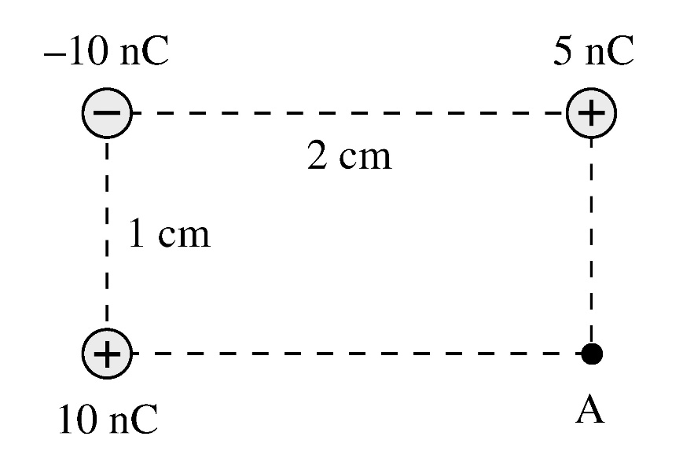
Example: using superposition principle
Determine the magnitude and the direction of the electric field at point A.
Notes:
Answer: Sum the x and y components of the electric fields at A due to each of the three charges. The x component of the field due to the upper left charge is –k(10E-9)/(r^2)*cos(theta) where r^2 = 0.01^2+0.02^2 = 5E-4 m^2 and theta = atan(0.5) = 27 degrees, so Ex1 = 1.6E5 N/C to the left. Ey1 = -k(10E-9)/r^2*sin(theta) = 8.0E4 N/C up. Ex due to the upper right charge is zero. Ey due to this charge is Ey2 = k(5E-9)/(0.01^2) = 4.5E5 N/C down. Ex to the lower left charge is Ex3 = k(10E-9)/(0.02^2) = 2.25E5 N/C to the right. Ey3 = 0. Adding we get Ex = Ex3-Ex1 = 6.5E4 N/C to the right and Ey = 8E4-4.5E5 = 3.7E5 N/C down. The total field is sqrt(Ex^2+Ey^2) = 3.8E5 N/C and the direction is atan(Ey/Ex) = 80 degrees below the horizontal and to the right.

